Slide 1
Predicting Customer Churn in the Telecommunications Industry
-Rhea Kagti
-Abhijeet Singh
-Jaya Lekhrajani

Slide 2
Business Case
Objectives:
To predict if a customer is likely to discontinue using the services of a telecom provider using learning methods and understand the factors that drives them to their decisions
To understand the customer survival function in order to gain knowledge of customer churn over the time of customer tenure. In a nutshell, we are trying to find out why and when will churn occur.
End-User: Marketing team and policy-makers of telecom organization

Slide 3
EDA, Feature Engineering, Correlation and Survival Analysis using Power BI

Slide 4
Prediction Model
Model Name | R Square
Two Class Boosted Decision Tree | 92.7%
Two Class Averaged Percepton | 84.2%
Two Class Bayers Point Machine | 84.9%
Two Class Decision Forest | 93.4%
Two Class decision Jungle | 93.4%
Two Class Locally- Deep SVM | 90.7%
Two Class logistic Regression | 85.2%
Two Class Neural Network | 93.1%
Two Class SVM | 83.2%

Slide 5
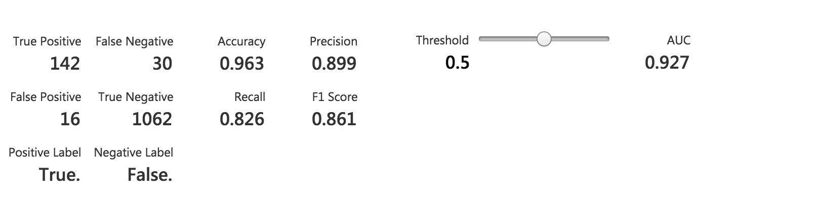
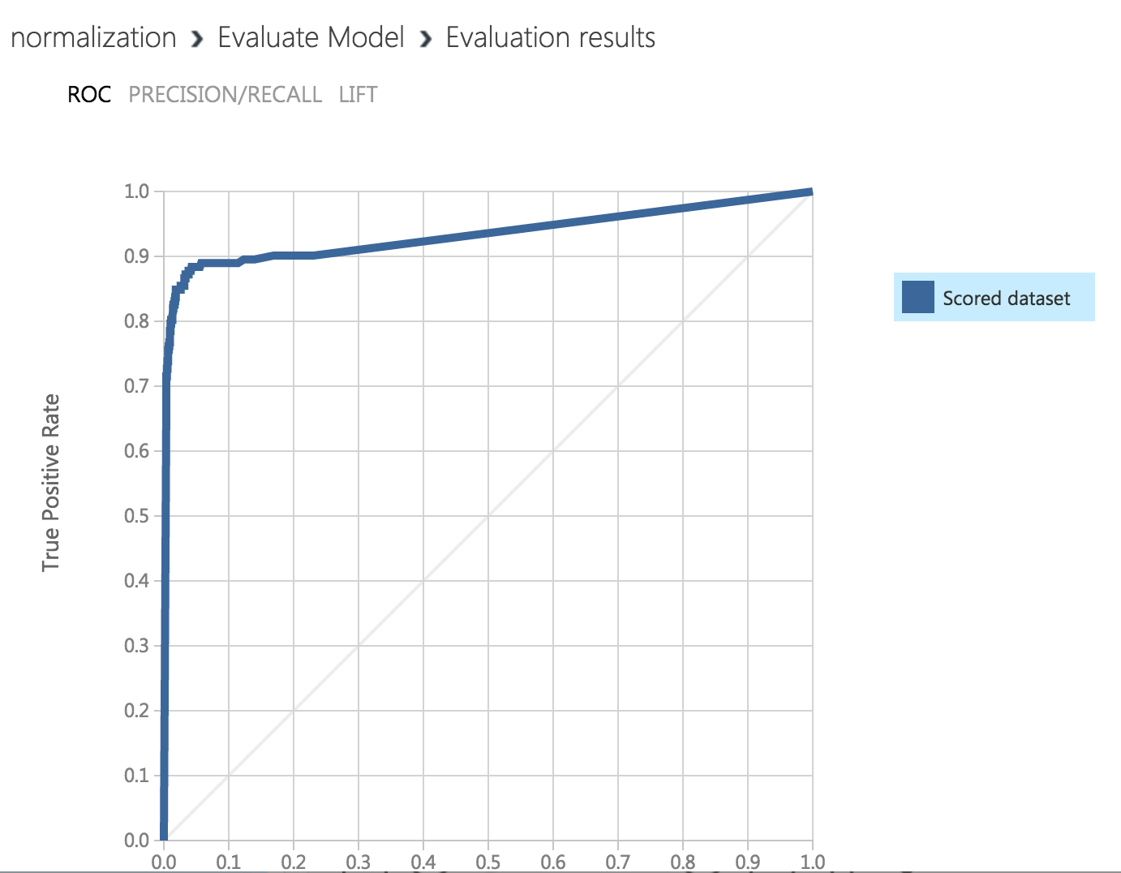
Model Selected
Two-Class Boosted Decision Tree

Slide 6
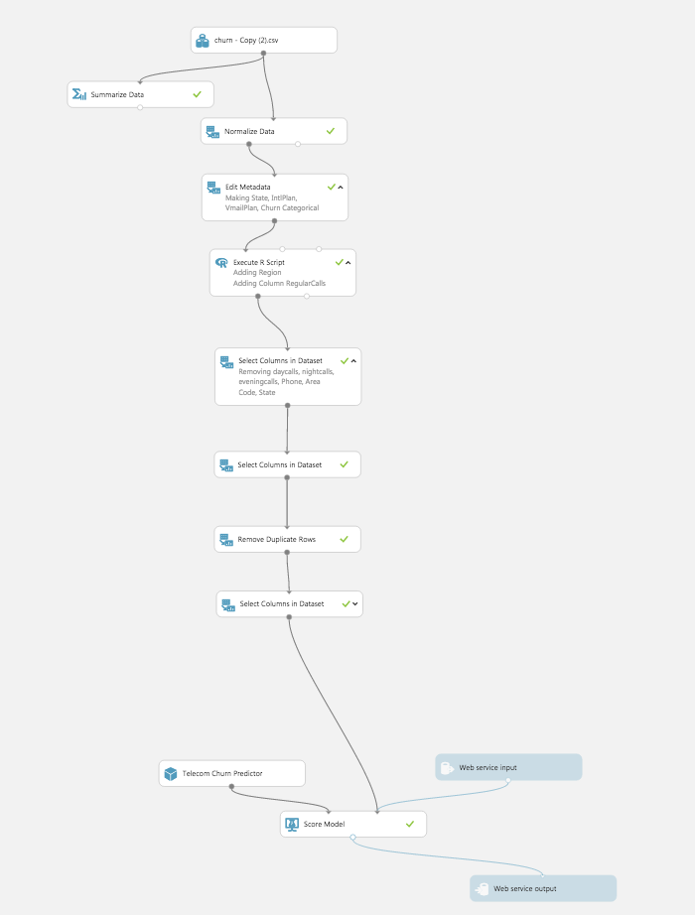
Final Azure Pipeline

Slide 7
Conclusion
High correlation between Daytime call charge and Churn to deal with this the company may reduce daytime call tariffs.
Other service providers maybe providing better rates therefore customer are leaving.
There could be a problem in the International Plan as very few people are taking the plan and the people who are taking it are leaving the service provider.
Voice Mail Plan is not so popular amongst the people. But the people who have taken it seem to be happy with it therefore, the company could advertise more on the voicemail plan.
Customers Account Duration doesn’t seem to have a great impact on the churn Rate, the company might not have any benefits for loyalty customers.
The customer service calls should be less, as that is an important factor for churn.
On Survival Analysis we found that the chance of a customer leaving the company increases as 100 to 120 months of owning the acco

